Slide 1
Illuminate Ed: A Tutorial
1. Logging In
2. Creating an Assessment
3. Scanning Student Answers
4. Viewing Results

Slide 2
To login, click on “Illuminate Ed” under Staff Links on the homepage. Use your full “@elps.us” address, and the password YOU created. If you can’t remember it, retrieve it using the “forgot password” link under the login.

Slide 3
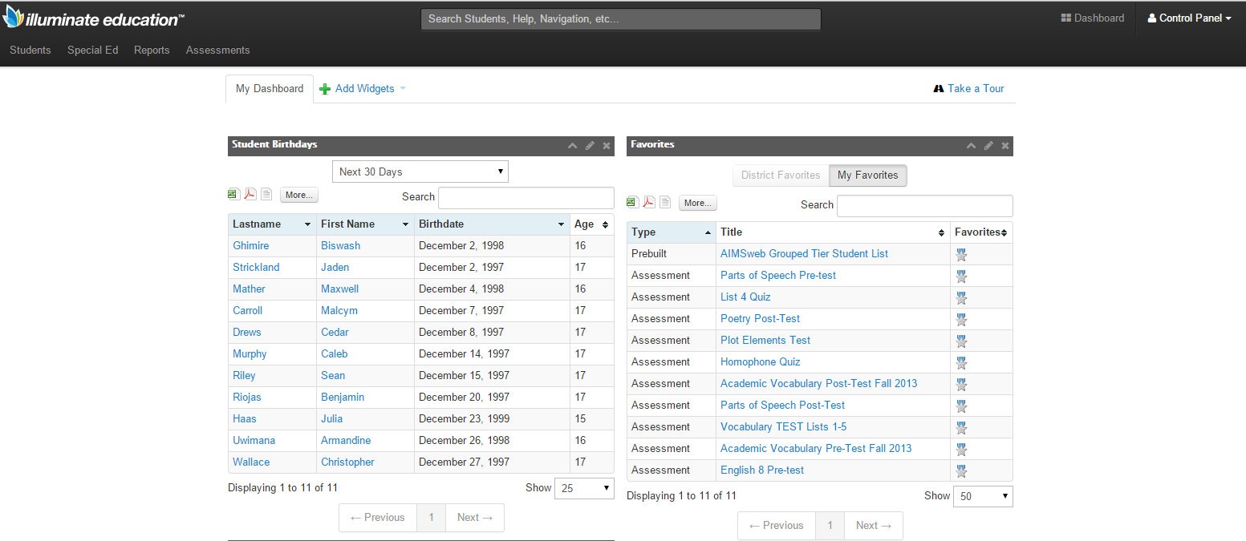
Your home screen will look something like this:
“Dashboard” will always bring you back to this page if you get lost. “Control Panel” is where you can change important items like your password, or the date range of the kids you have taught historically. You can also access some helpful tutorials.
These are widgets, which you can customize.

Slide 4
To create an assessment, click “Assessments”, “Create a New Assessment.”

Slide 5
If you want to quickly scan an assessment that you may or may not keep, click “On the Fly.” You will probably want to keep the assessment, though, so click, “Manual Setup”, and list how many questions are in your assessment.

Slide 6
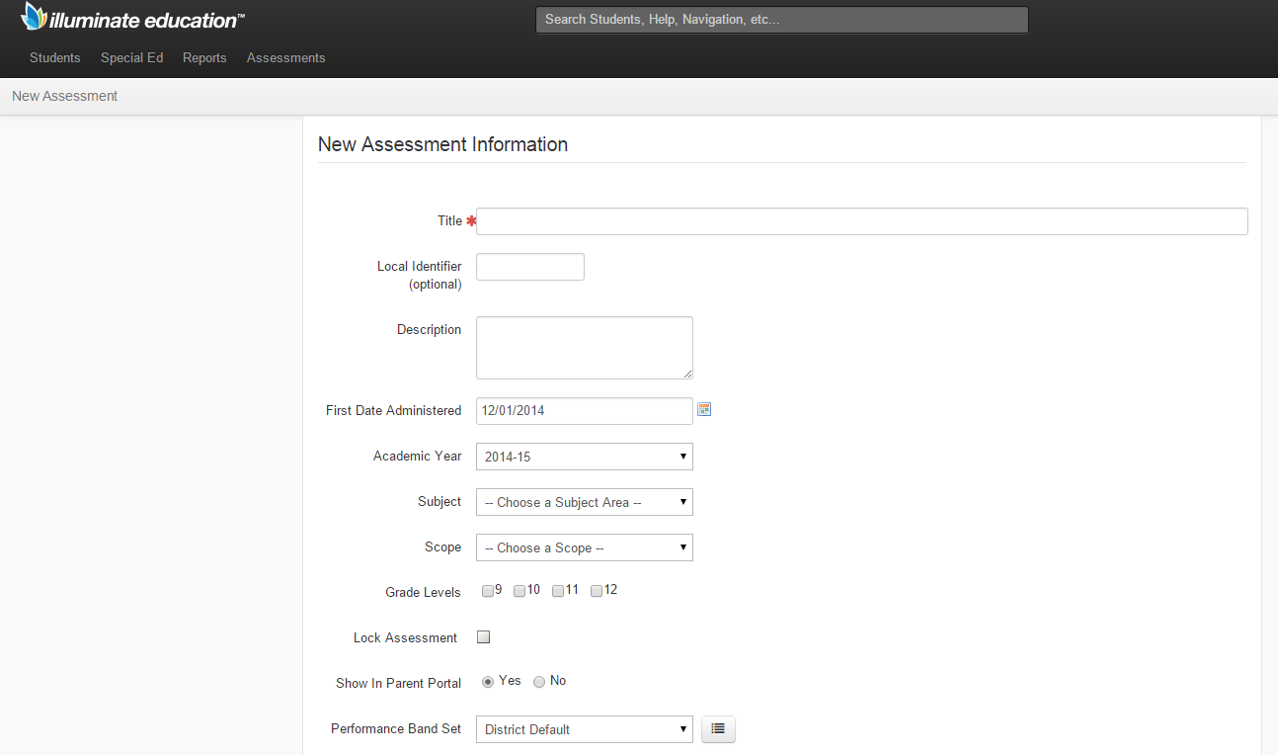
This will prompt you to title your assessment. You can customize anything else you want, but it’s not necessary. Click “Save” when finished (the blue button at the bottom, that is not pictured here).

Slide 7
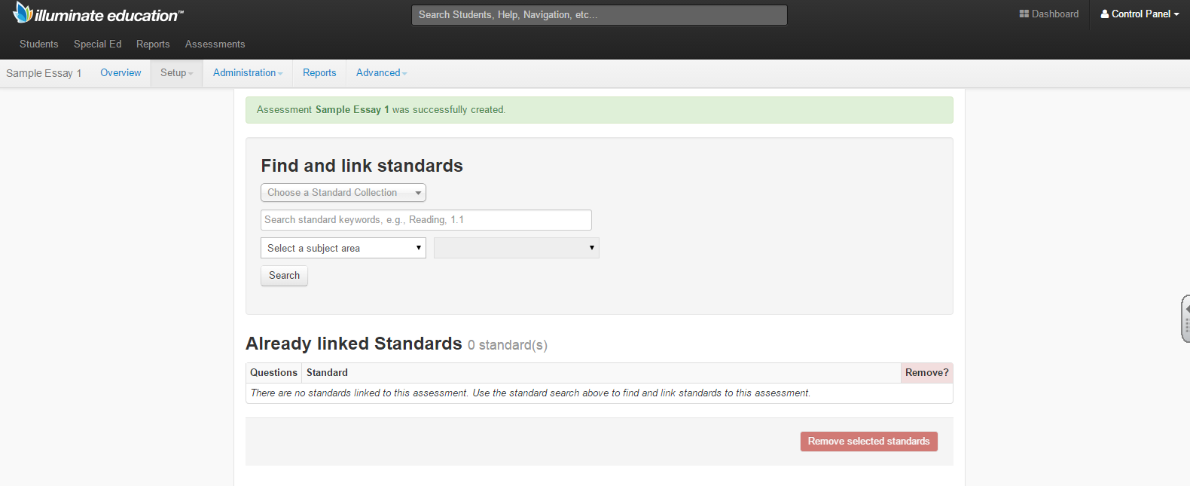
That will bring you here. Your assessment is made. Next enter your key.

Slide 8
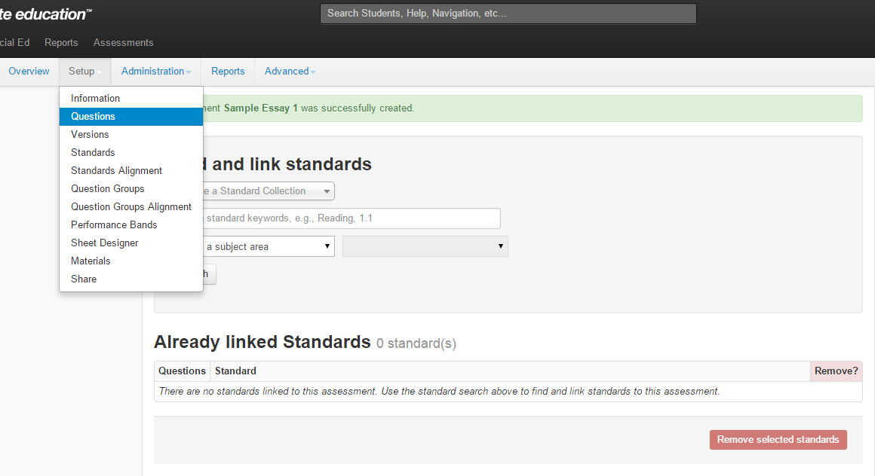
To do this, click “Set-up,” “Questions”.

Slide 9
Enter the answers to each of the questions and press “Save.”
You can scan a key if you already have one bubbled.
You can add more questions here if you want to.
See the next slide for question options.
You can delete a question, too.

Slide 10
You can also customize your answers if you wish.
Click the little blue “?” next to Advanced for more options.

Slide 11
When you’re done, click “Overview” to go to the homepage of the assessment.

Slide 12
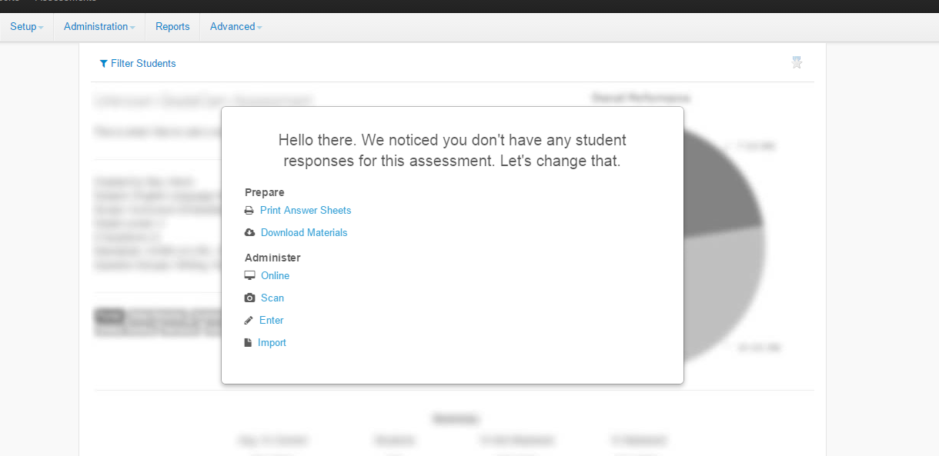
This is where you can print answer sheets, or scan them once students have completed your assessment. Unfortunately, this handy shortcut disappears once you’ve scanned your sheets.

Slide 13
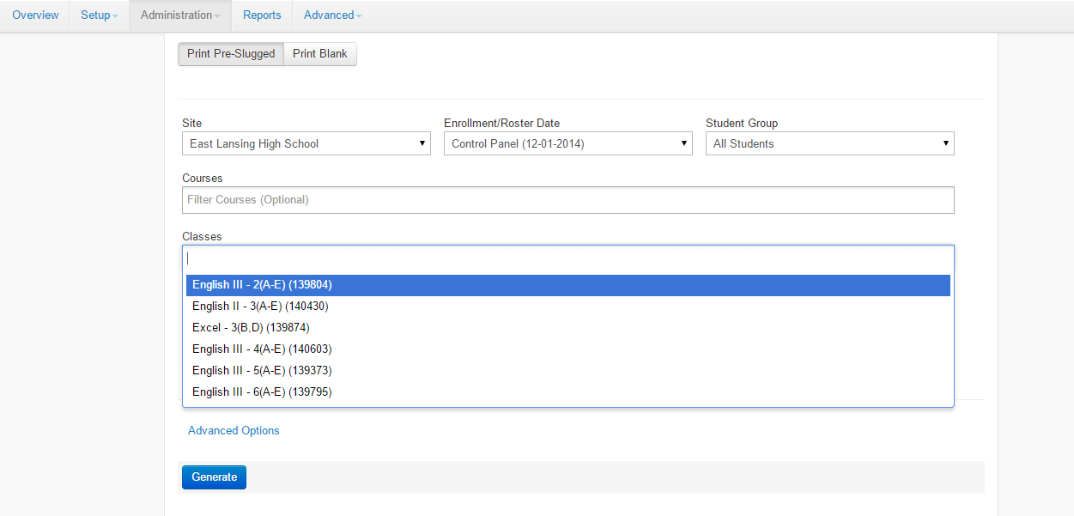
Clicking “print answer sheets” will take you here. Select the class you wish to test, then click “generate”

Slide 14
That will bring to you your bubble sheets. You can print them directly here. However, the sheets print small and difficult to use. I recommend clicking “download” to save them to your computer and print them from the subsequent PDF.

Slide 15
Click “overview” when finished to take you back to the homepage of the assessment. Click “scan” to scan the bubble sheets after students have taken the assessment.

Slide 16
That will take you here. You should see whatever is under your doc cam. If you don’t see anything there, you may need to download the plugin that allows the camera to work. If this happens, be sure to restart your computer after downloading. Otherwise, you can simply start scanning. Click “save” when finished.

Slide 17
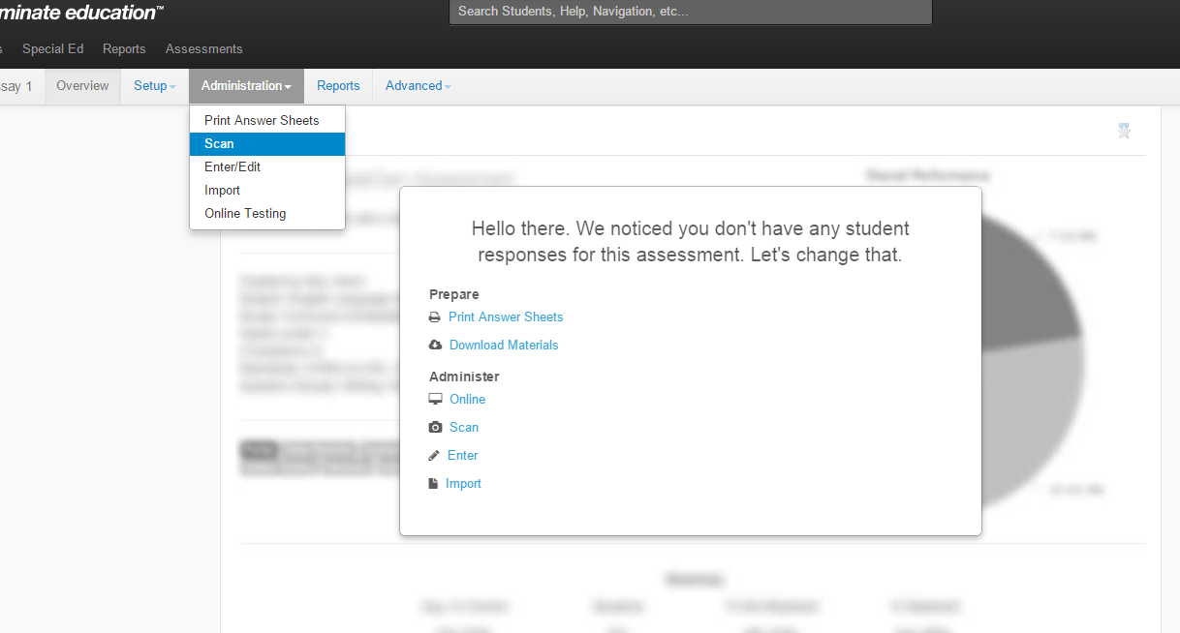
This handy shortcut
will disappear when you’ve scanned your bubble sheets. If you still need to do some scanning, click “administration” and “scan” to take you to the scanning screen.

Slide 18
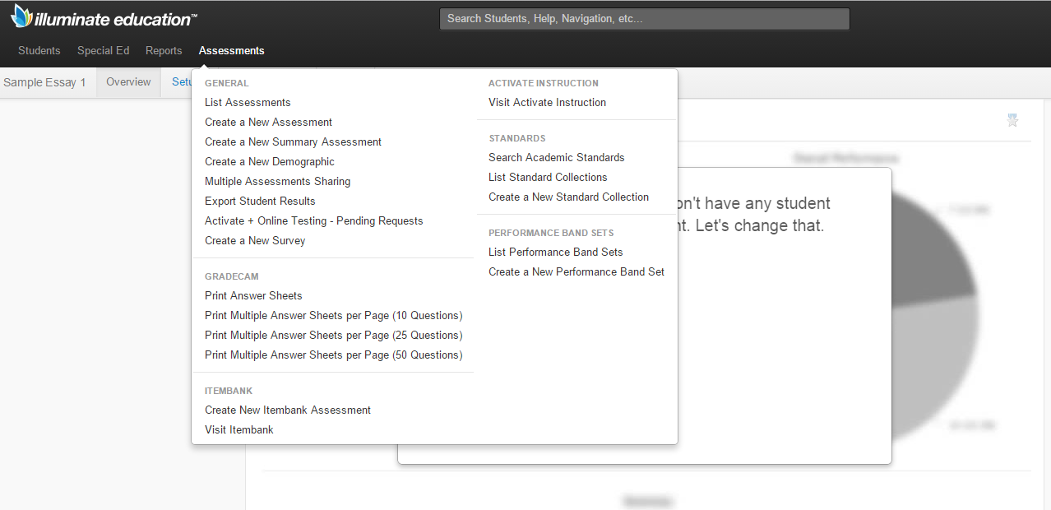
To find your assessment again later, click “Assessments”, and then “List Assessments”.

Slide 19
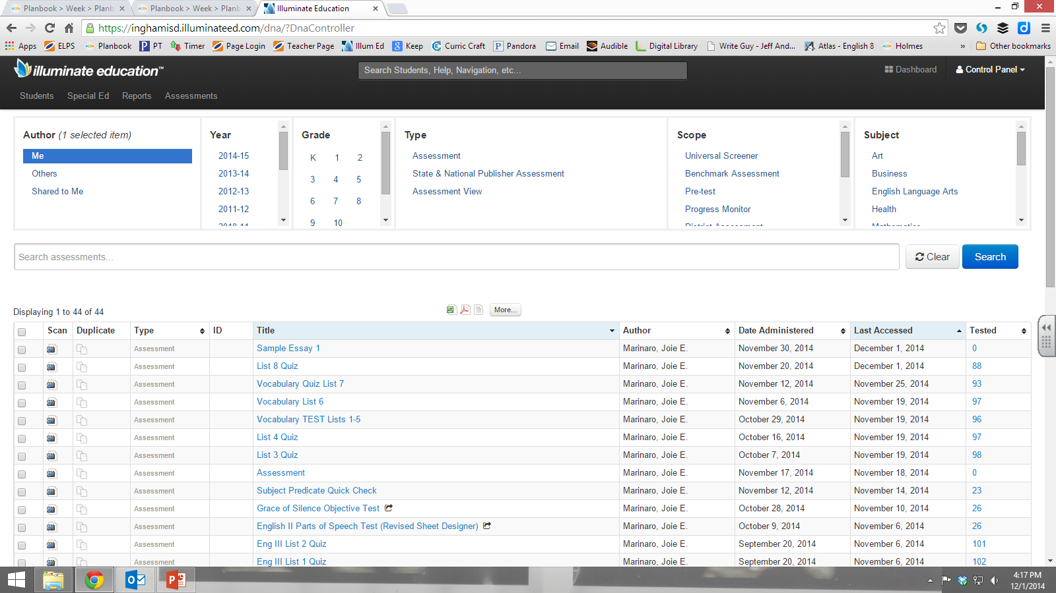
This will give you a list of assessments. Be sure to select ONLY the filters that define your assessment. Scroll down on each domain to ensure that all the rest are unselected.
These are all filters.

Slide 20
After typing the title of your assessment, and clicking only the filters you need, click the blue “search” button. Select your assessment from the list.

Slide 21
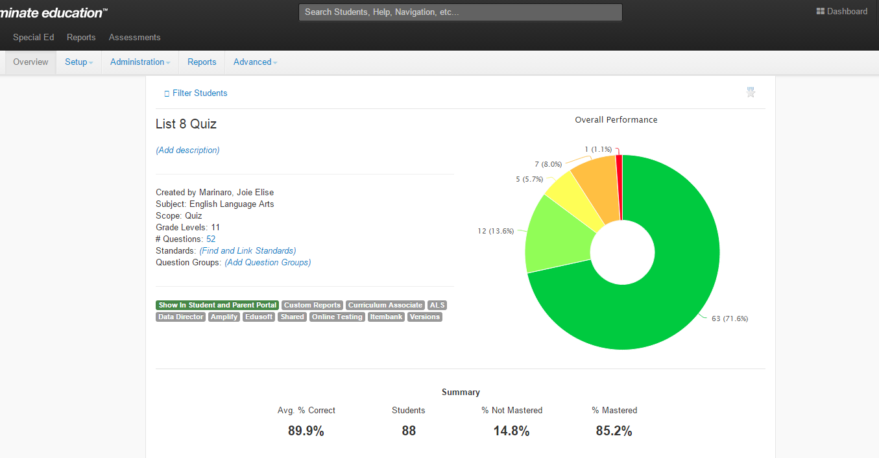
That will bring you here, where your results will be color-coded and displayed if you’ve scanned them, instead of the scanning shortcut.

